Slide 1
Acute Kidney Injury

Slide 2
Learning Ojectives
Definition
Pathogenesis
Causes
Lab Investigations
Treatment

Slide 3
Introduction
AKI – largely replaced by the older term Acute Renal Failure.
Identifying the Incidence and prevalence – difficult
World wide variation in the accepted definition of AKI
AKI was iatrogenic and preventable

Slide 4
Definition
Abrupt ( 1 to 7 days) and sustained ( more than 24hrs) decrease in Kidney function.
In 2003 new classification was proposed by ADQI- RIFLE criteria
This provides graded definition of AKI
3 Grades in increasing the severity
2 outcome

Slide 5
3 Grades
Risk
Injury
Failure
2 outcome
Loss
ESRD

Slide 6
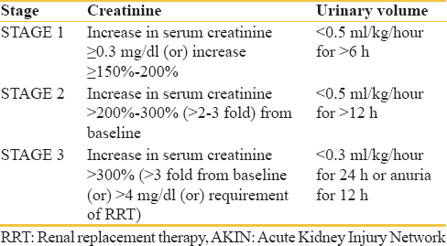
Acute Kidney Injury Network

Slide 7
Pathogenesis
Tubular
Glomerular

Slide 8
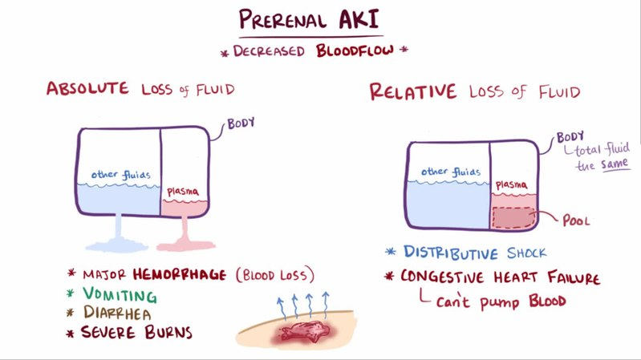

Slide 9
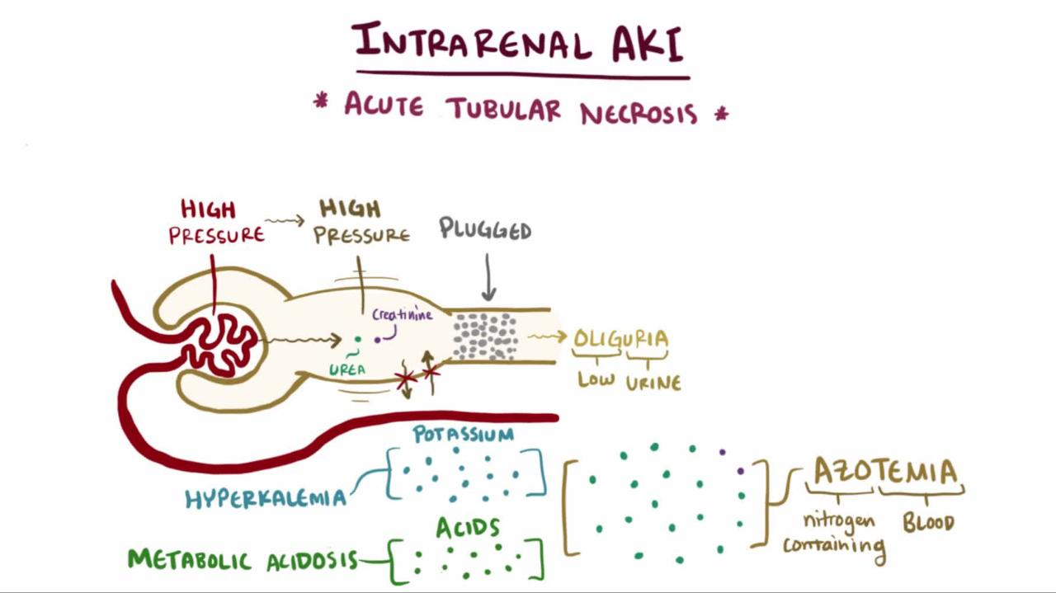

Slide 10
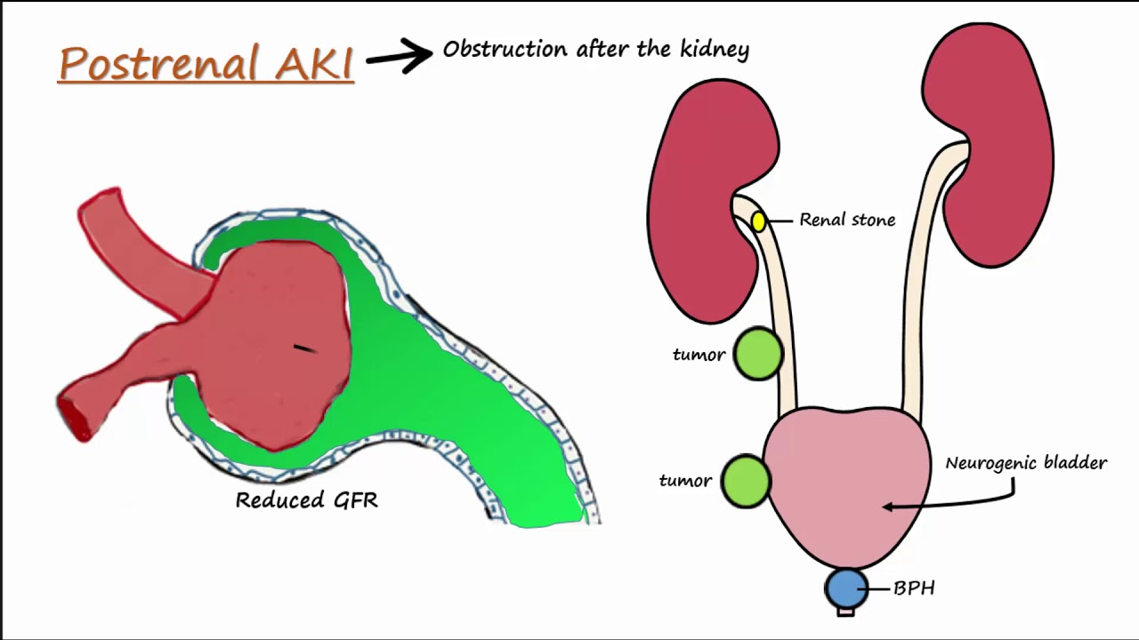

Slide 11
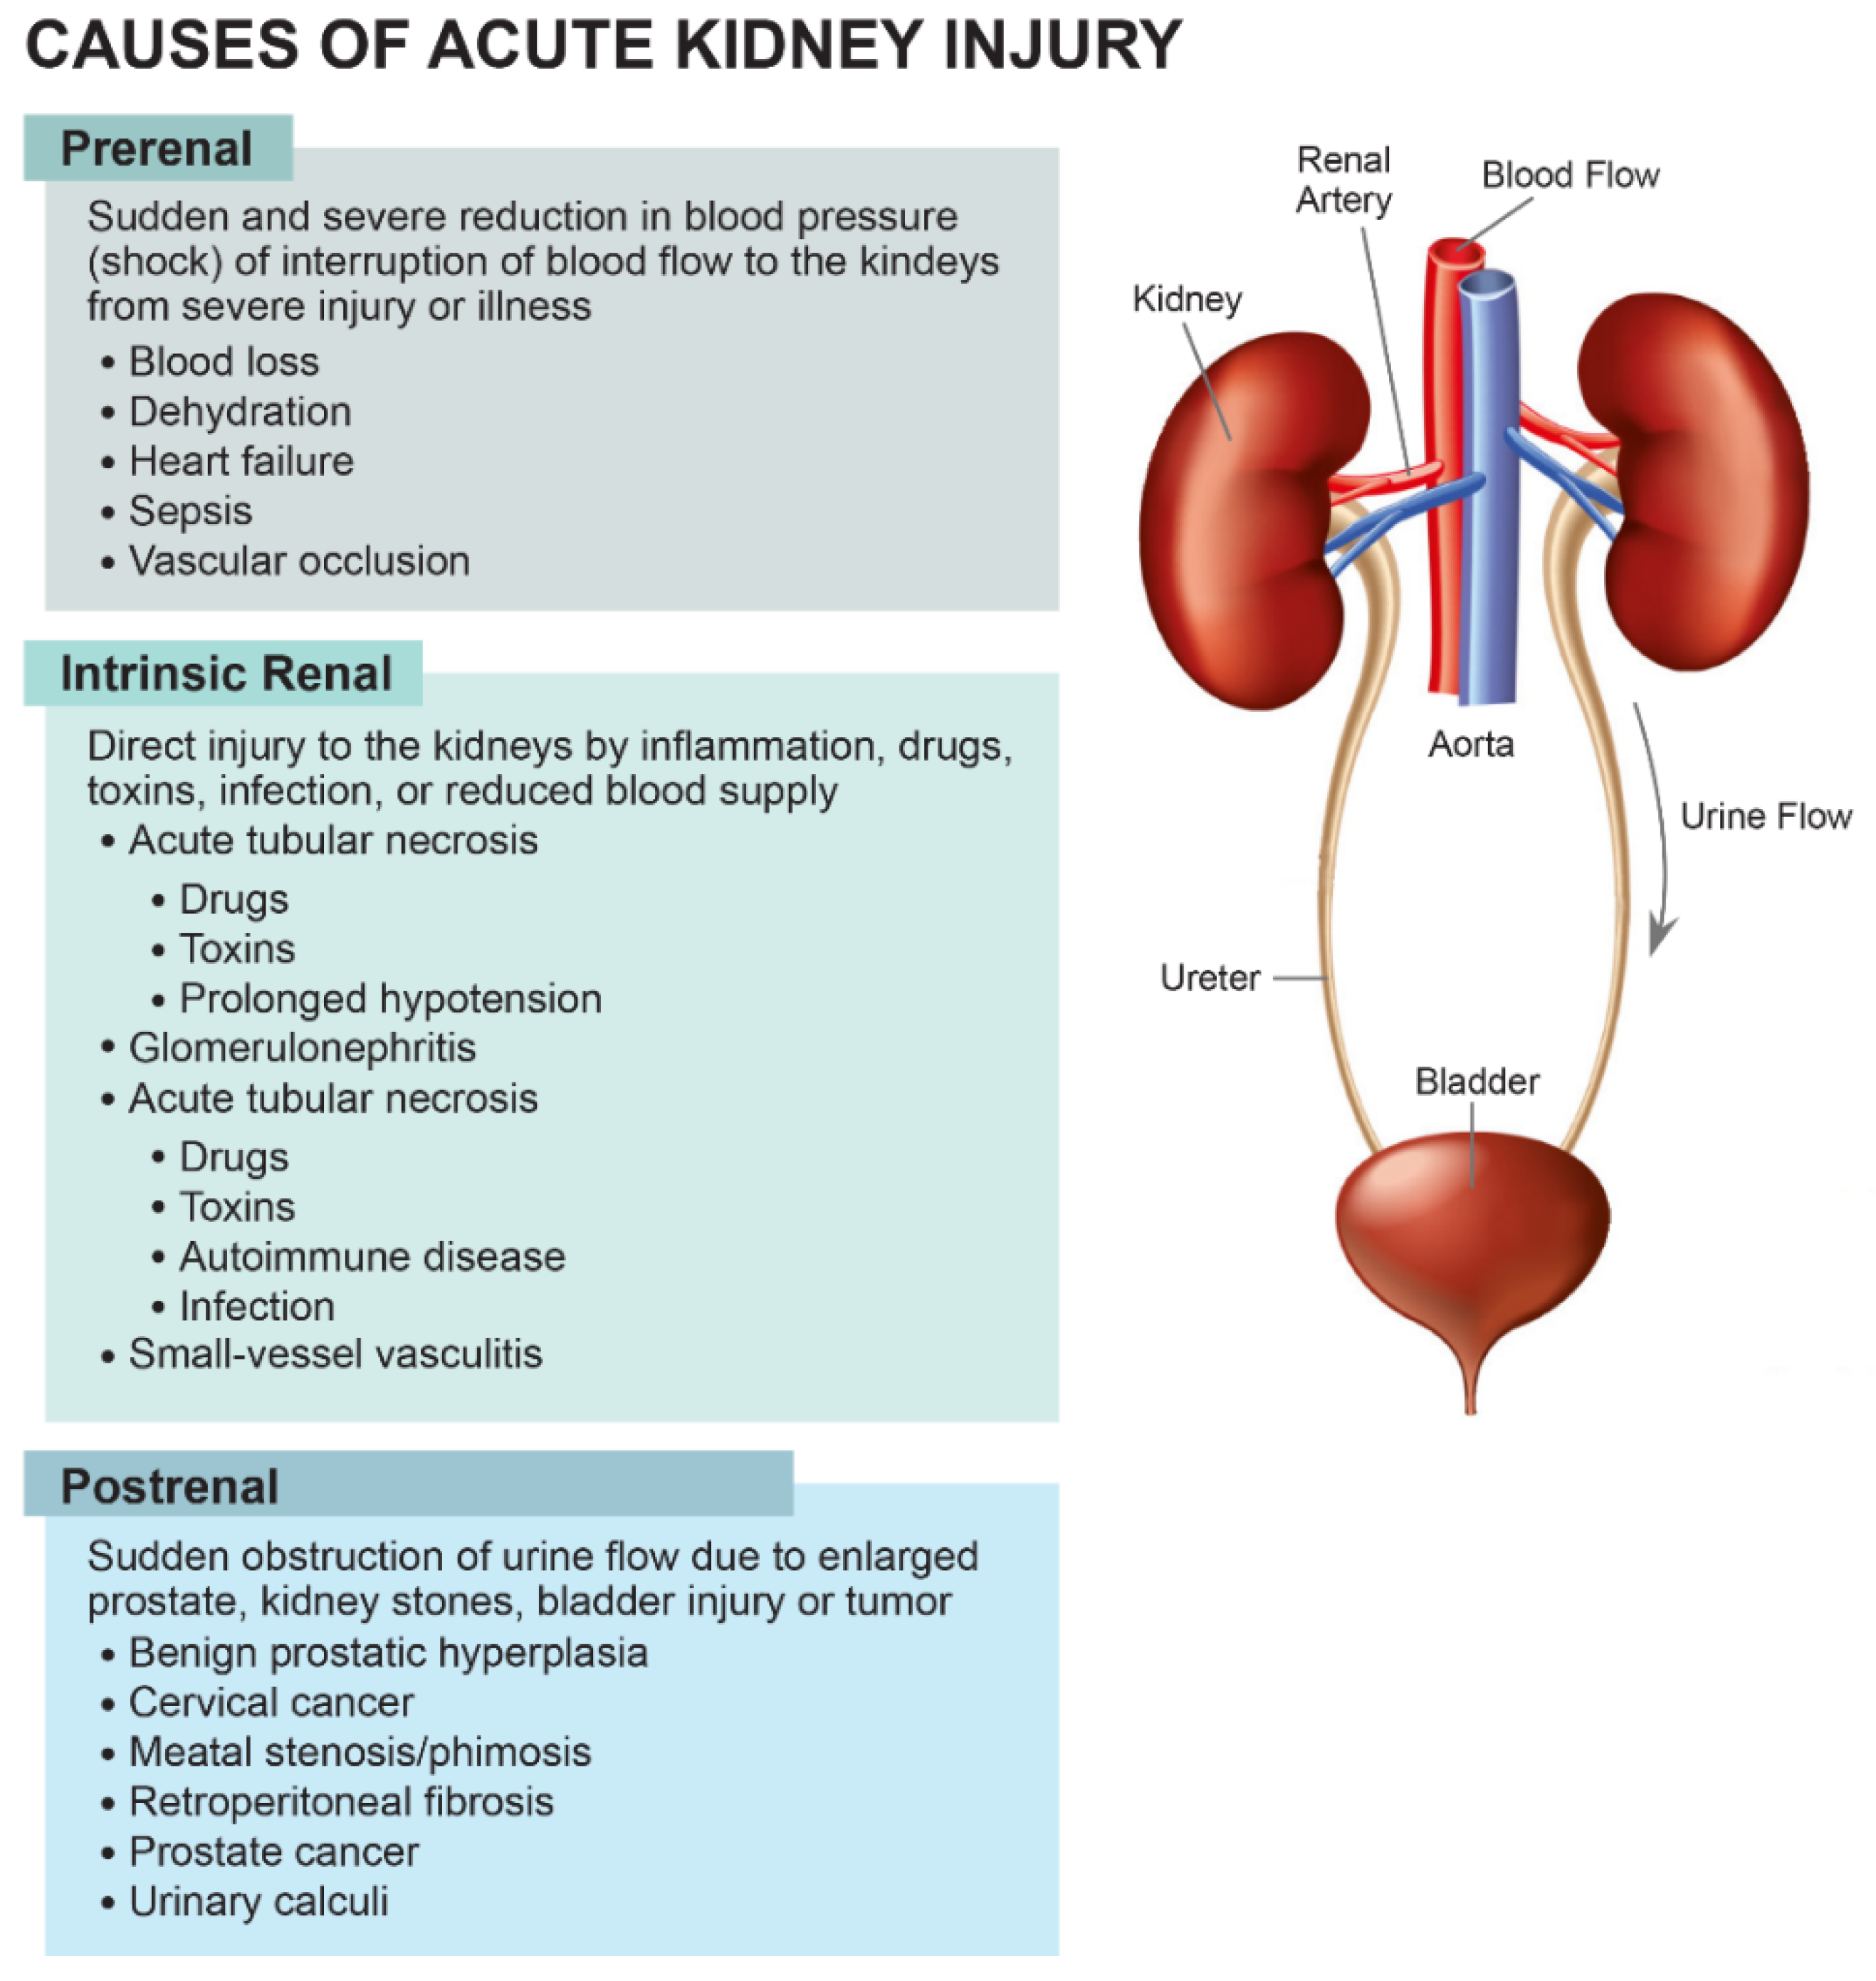

Slide 12
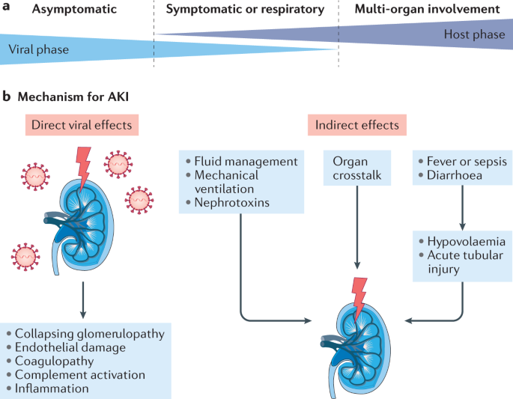

Slide 13
AKI is caused by Ischemia
Initiates complex response of hemodynamic changes, Endothelial damage, Endothelial cell injury.
Intrinsic AKI caused by primary glomerular vascular or interstitial disorders.
So all patients undergoes urine analysis.
Many cases kidney lesion seen on histology and it s referred as ATN caused by Ischemic / nephrotoxic injury to kidney

Slide 14
In 50% hospital acquired AKI cause is multifactorial and pathogenesis is uncertain
But well known clinical pattern is seen
Oliguria / anuria
Abnormalities indicating tubular dysfunction

Slide 15
Lab Investigations

Slide 19
Contrast Induced AKI

Slide 20
Risk Factors
Old age
Sepsis
DM
CAD

Slide 21
Prevention
Early Identification of Intravascular volume depletion
Cessation of Nephrotoxic drugs
Prompt Administration of IV crystalloid solution 0.9% NACL

Slide 22
Early Predictors of Acute Kidney Injury:A Narrative Review
Xiaoqin liu et al
Kidney and Blood Pressure Research 2016;680-700

Slide 23
Introduction
AKI has been increasing in clinical renal medicine.
This journal summarises the current clinical and research progress of some important biomarkers of AKI

Slide 24
AKI biomarkers
Biomarkers of glomerular Injury
Biomarkers of Renal tubular Injury
Urinary Biochemistry in Acute Kidney Injury

Slide 25
Biomarkers of glomerular Injury
Matrix Mettaloproteinase 9(MMP-9)
Cysteine Rich 61(Cyr61)
Cystatin C(CysC)

Slide 26
Biomarkers of Renal tubular Injury
Tissue inhibitor of Metalloproteinase 2(TIMP-2)
Kidney injury Molecule 1(KIM1)
NGAL
IL18 &IL6
Liver type fatty acid binding protein (L-FABP)
Na /H Exchanger isoform protein(NHE3)
Beta 2 microglobin
RBP
Clusterin
osteoactivin

Slide 27
Urinary Biochemistry in Acute Kidney Injury
Fractional excretion of sodium(FeNa)
Fractional excretion of urea(FeU)
Urine microscopy

Slide 28
Others
Netrin 1
Fetuin A
Insulin like growth factor binding protein 7(IGFBP7)
Trefoil factor 3(TFF3)
Monocyte chemotactic protein 1(MCP1)
Soluble triggering receptor expressed on myeloid cells 1(sTREm1)

Slide 29
Matrix Mettaloproteinase 9(MMP-9)
Named after metal ion cofactors
92kDa type IV collagenase gelatinase B
Primarily expressed in the glomerulus
MMP9 levels in patients with sepsis were significantly increased at 6hrs and reached it peak at 12hrs
Urinary MMP9 is increased in patients with AKI when compared with CKD

Slide 30
Limitation
High susceptibility to inflammatory factors such as UTI

Slide 31
Cysteine rich 61(Cyr61)
Heparin binding extracellular matrix associated protein of CYR61/CTGF/NOV
In renal tissue of healthy adults Cyr61 is secreted by podocytes
It has protective effects on mesangial effects
Cyr61 increases 3-6hrs after renal ischemic damage and it reaches its peak at 6-9hrs and it gradually decreases
Initially considered as biomarker of AKI but now it became sensitive marker of podocyte damage

Slide 32
Limitation
Disappears very quickly in urine

Slide 33
Cystatin C
Cystein protein inhibitors family with low molecular weight 13kDa
Synthesized by all nucleated cell of the body and released into plasma
Due to smaller size it easily get filtered by the glomerulus and completely reabsorbed because of positive charges.
Blood CysC is the early biomarker than the SrCr.
This can detect AKI 1-2days earlier than SrCr
Sensitivity is also higher than SrCr

Slide 34
Limitation
Influenced by thyroid functions, smoking, elevated CRP

Slide 35
Tissue inhibitor of Metalloproteinase 2(TIMP-2
Family of MMP2 gene located in Chr 16q21
One of the biomarker for cellular stress in early phase tubular injury
When DNA damage occurs TIMP2 level is increased in renal tubules.
More sensitive than other markers in prediction of moderate to severe AKI within 12hrs

Slide 36
Kidney injury Molecule 1(KIM1)
100kDa type I transmembrane glycoprotein
1st isolated by Ichimura et al in 1998
Undetectable in atropic kidney therefore it play a important role in early tubular damage.
Highly sensitive for the diagnosis of AKI
Plasma KIM 1 level is increased in patients with AKI
Sometimes shows positive corelation with hypertension and ischemia

Slide 37
Urinary KIM1 may be the potential indicator for the early diagnosis of AKI
Reported as biomarker in 2002,early biomarker within 24hrs.
Urinary KIM1 differentiate ischemic AKI from prerenal AKI and CKD
Not influenced by UTI and contrast media
Urinary KIM1 was superior to SrCr and BUN

Slide 38
KIM1 may be good biomarker for kidney injury because
Cannot detected in normal renal tissue
Expressed only in damaged proximal tubular epithelial cells
Initial stage of ischemia

Slide 39
Neutrophil gelatinase associated lipocalin(NGAL)
Originally identified in human neutrophil and later found to be distributed widely in immune cells and various organs
Member of lipocalin family with 25kDa
Produced by activated neutrophil of proximal tubule and bound to neutrophil gelatinase
In renal ischemia NGAL increased
NGAL levels in plasma and urine has significance in predicting AKI
Urinary NGAL detected within 3hrs after acute renal ischemia

Slide 40
NGAL increased in burn pts who develop AKI during 1st week after burn
Umbilical NGAL could predict AKI in neonates with HLHS
NGAL is influenced by infections and malignancy

Slide 41
IL 18
Belong to IL1 family with molecular wt 18kDa
Novel cytokine play a important role in Tcell helper type 1 response
2004 IL18 level was significantly increased in pts with AKI
Reported to raise 2days before SrCr
Early sensitive predictor of AKI
Increase within 4-6hrs and reaches its peak by 12hrs and remains high for 48hrs

Slide 42
Urinary IL18associated with severity and prognosis of AKI(100microgm/L)
It is the only predictive indicator for AKI

Slide 43
IL6
Proinflammatory cytokine expressed during tissue injury
Increased within 6hrs post cardiac surgery

Slide 44
Liver type fatty acid binding protein (L-FABP)
Belongs to Fatty acid binding protein with molecular mass 14Kda
Widely exist in metabolically active tissues
2 different types identified.
FABP identified in human kidney L-FABP
H-FABP
Elevated FABP indictes
HF
CKD
DM

Slide 45
Na /H Exchanger isoform protein(NHE3)
Present in apical membrane of cells in PCT and Loop of henele
Usually detected in ICU patients with AKI
Aetiology yet undetermined

Slide 46
Beta 2 microglobulin
Protein – cell surface in a non covalently associated with alpha chain of MHC class I
Normal level in urine is less and it increase when there is tubular damage
Sensitive marker for PCT injury

Slide 47
RBP
Transport protein for Vit-A
Increase in RBP in first 2days of life was predictive clinically significant AKI infant following birth asphyxia

Slide 48
Clusterin
Heterodimeric protein with 80kDa
Increased in AKI caused by PCKD, nephrectomy, RCC

Slide 49
Osteoactivin
Glycoprotein with 6500-115000daltons
Usually increased in cyclosporin A induced nephrotoxicity

Slide 50
Netrin 1
Small secreted protein assoc., with laminin
Initially expressed in nervous system and later found in many organs
Netrin 1 increased in AKI caused by ischemia, contrast dyes, drugs and sepsis

Slide 51
Fetuin A
Negative active phase protein synthesized by liver and released into circulation
Pathological significance is still not clear in AKI
Increased in cisplastin induced renal damage

Slide 52
Insulin like growth factor binding protein 7(IGFBP7)
Glycoprotein with 30kDa secreted by epithelial cells, endothelial cell and smooth muscle
Detected in plasma , urine
Increased in AKI caused by sepsis, ischemia

Slide 53
Trefoil factor 3 (TFF3)
Small molecule polypeptide and also known as intestinal trefoil factor
Urine TFF3 decreases following tubular damage
Used as sensitive marker

Slide 54
Monocyte chemotactic protein 1(MCP1)
Increased in ischemia

Slide 55
Soluble triggering receptor expressed on myeloid cells 1(sTREm1)
Plays a important role in prediction of sepsis assoc., AKI
Mechanism not been clearly demonstrated

Slide 56
Fractional excretion of sodium(FeNa)
The amount of salt (sodium) that leaves the body through urine compared to the amount filtered and reabsorbed by the kidney.
In most normal subjects, the fractional excretion of sodium is usually less than 1 percent but may be raised with an increase in salt intake.
In acutely azotemic patients, a low fractional excretion of sodium usually indicates a prerenal process that is responsive to volume repletion.

Slide 57


Slide 58
Fractional excretion of urea(FeU)
Determines the cause of renal failure.
Similar to the FENa, but can be used on patients on diuretics.
A fractional excretion of urea (FEUrea) of < 35% is suggestive of pre-renal azotemia.

Slide 59
(FEUrea in percent) = (sCr X uUrea) / (sUrea x uCr) / 100.

Slide 60
Thank you

Slide 61
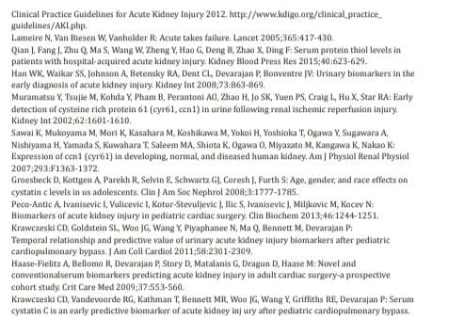
References
Clinical biochemistry – Tietz

