Slide 1
CELL MEMBARNE AND TRANSPORT MECHANISM
Dr.S.Suganya
Dept of Biochemistry

Slide 2
Learning Objectives
At the end of the session
Able to describe fluid mosaic model
Structure of cell membrane
Different function of various components of cell membrane
Different type of membrane transport
Endocytosis and exocytosis

Slide 3
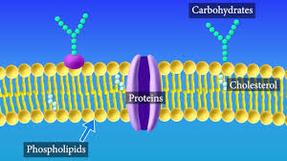
Overview
Cell membrane is the physical barrier that separates interior of the cell from outside environment.
Highly selective permeability properties

Slide 4
Biochemical composition of membranes
LIPID CONSTITUENTS
PROTEIN CONSTITUENTS
CARBHOHYDRATE CONSTITUENTS

Slide 5
Lipid constituents
Major lipid present are
Phospholipid
Glycosphingolipids
Cholesterol

Slide 6
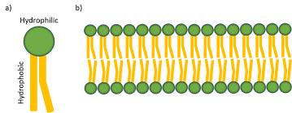
Phospholipid
Glycerophospholipid is most common
Contains both Hydrophilic and Hydrophobic region
Called as amphipathic

Slide 7
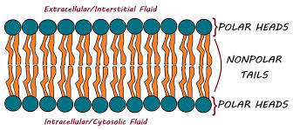

Slide 8
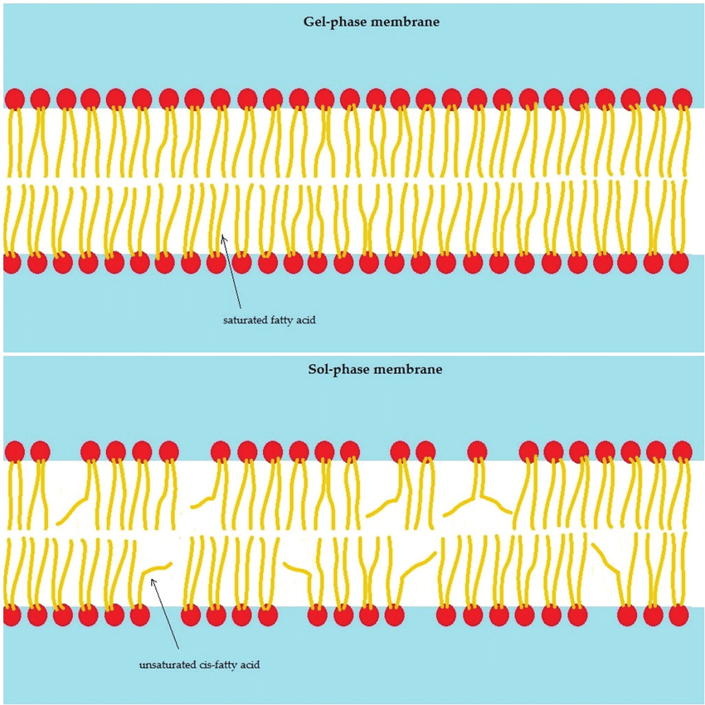

Slide 9
Sphingomyelin
Fatty acid and phosphate attaches sphingosine
It contains choline and ethanalomine

Slide 10
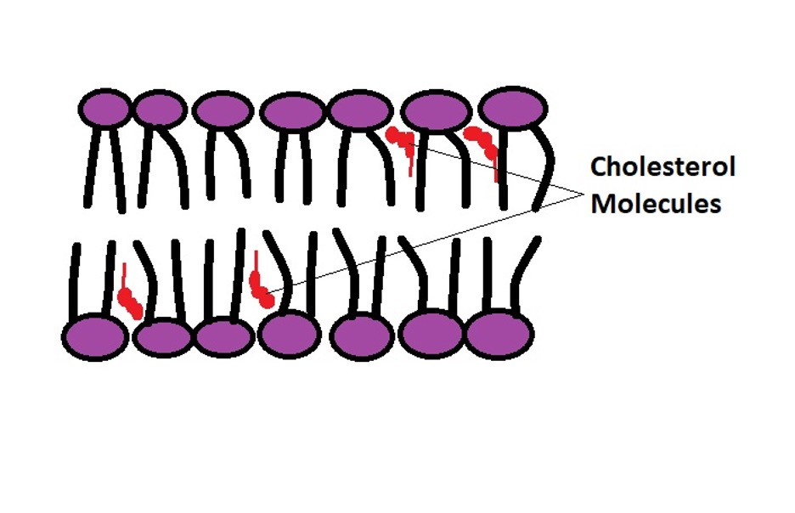
Cholesterol
Major sterol embedded between hydrophobic tails of phospholipid
Provides rigidity to membrane
Acts as fluidity buffer of membrane

Slide 11
Protein constituents
Major functional molecules of membrane
Acts as enzymes, pumps, transporter, channels and structural components
Two categories
Integral / intrinsic protein
Peripheral protein

Slide 12
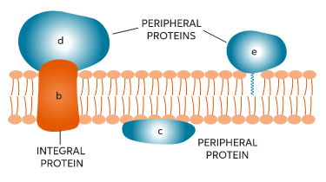

Slide 13
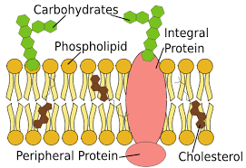
Carbohydrate constituents
Located in the External surface of membrane as oligosaccharides
Oligosaccharide attached to Protein / Lipids
Glycoprotein / glycolipid

Slide 14
Fluid Mosaic Model
Originally proposed by Davson and Danille in 1935- sandwich model
Later structure of bio membrane is described as Fliud Mosaic Model by Singer and Nicolson in 1972.
Membrane is asymmetric

Slide 15
It is dynamic structure because orientation and position keep changing
Fluidity depends on Lipid composition of membrane
Phospholipid undergoes Lateral diffusion, can rotate around axis and flip flop
Some protein embedded in outer layer and inner layer and in whole membrane
Carbohydrate attached to outer surface

Slide 16
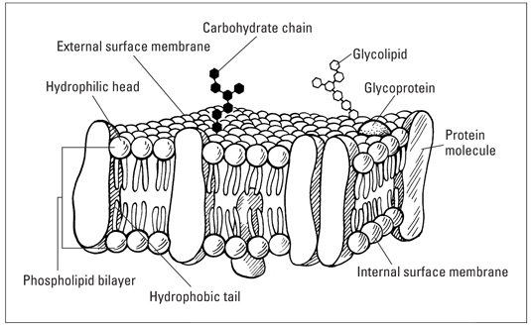

Slide 17
Factors affecting fluidity
Nature of fatty acid
Temperature
Cholesterol
Degree of unsaturation

Slide 18
Transport mechanism
Refers to collective mechanism that mediate passage of ions, small molecules through lipid bilayer.

Slide 19
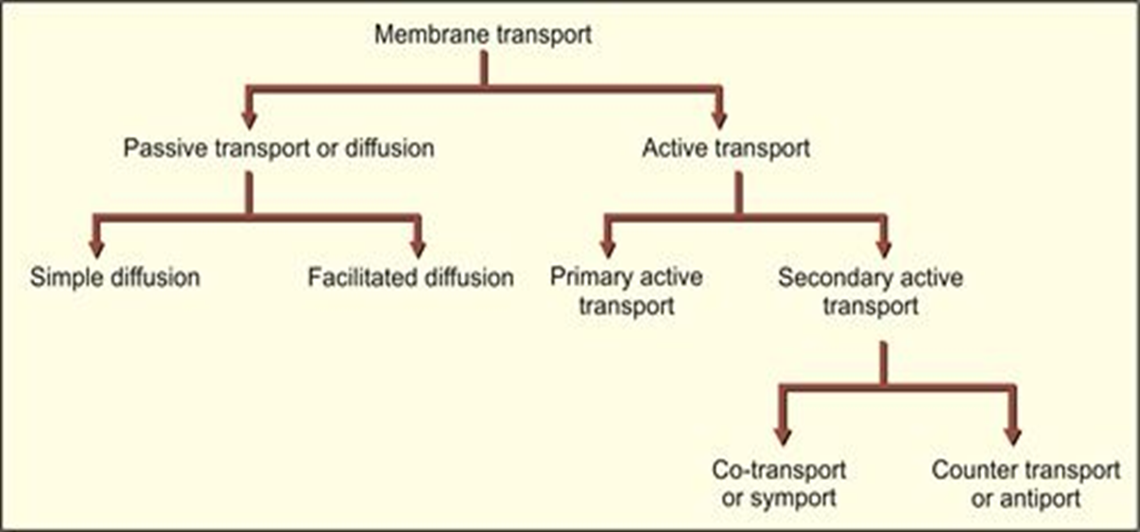

Slide 20
Simple Diffusion
Molecules moves passively through bilayer along the concentration gradient till the equilibrium reached.

Slide 21
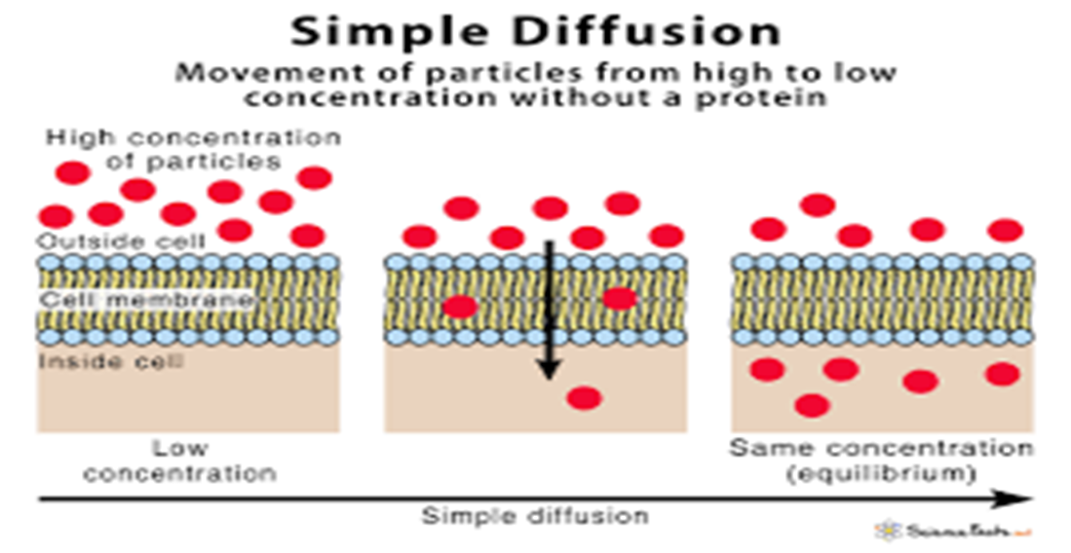

Slide 22
Does not require energy
Non polar molecules like gases and steroids freely diffuse across the membrane
eg: exchange of oxygen carbon di oxide in lungs

Slide 23
Facilitated Diffusion
As simple diffusion molecules moves from higher to lower concentration
But it is mediated by specific protein transporter/ ion channel
Does not require energy

Slide 24
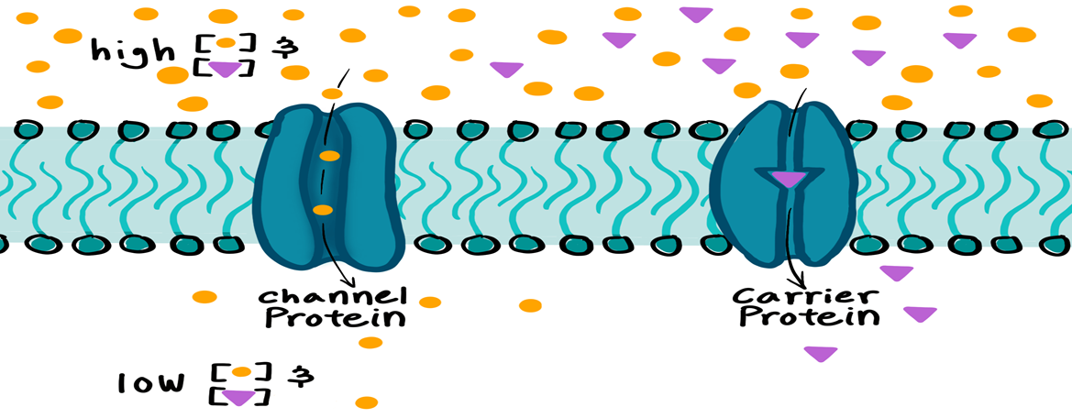

Slide 25
Ping pong mechanism
Carrier protein exist in two conformations
In ping conformation, exposed to the side with high solute concentration
In pong conformation, exposed to side with low solute concentration and it is released.
Process is reversible based on concentration gradient

Slide 26
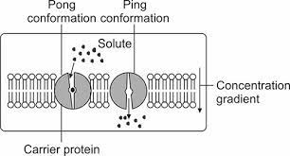

Slide 27
Ion channels
Span across the cell membrane allowing passage of Ions
Most of them are highly selective for only one Ions
Specific channels- Na, K, Ca, Cl

Slide 28
3 types
Ligand gated channels
Voltage gated channels
Mechanically gated channel / mechanosensitive channel

Slide 29
Ligand gated channel
Open or close binding of ligand
Ligands can be hormones, drugs, other Ion channel messengers
Ca2+ channels ER in muscle cell(sarcolemma) reponds to variety of metabolic and electrical stimuli release of Ca2+ in cytosol

Slide 30
Voltage gated channel
Responds to change in electrical potential across membrane which causes it open.
2 types
Voltage gated sodium channel
Voltage gated potassium channel

Slide 31
Mechanically gated channel
Responds to various mechanical stimuli
Components in various sensory receptors that respond to touch,pain pressure

Slide 32
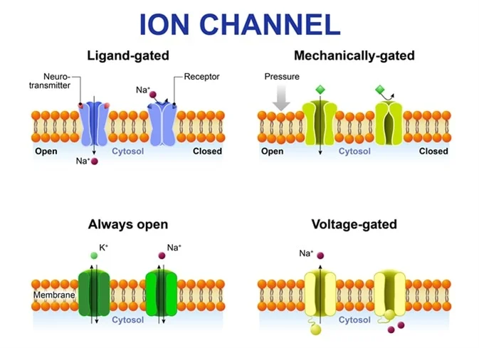

Slide 33
Active transport
Involves transport against concentration gradient
Requires energy
Involves specific transporter protein called pumps
2 types
Primary active transport
Secondary active transport

Slide 34
Primary active transport
Directly coupled hydrolysis of ATP to ADP and Pi
Secondary active transport
Transport of one solute against conc., gradient coupled with transport of another along its electrochemical gradient
No direct hydrolysis of ATP

Slide 35
Transporter protein
Uniport
Symport
Antiport

Slide 36
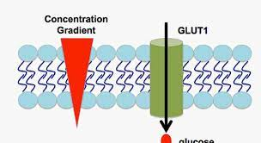
Uniport transport
Only one type of molecule transported across the membrane by transporter / channel

Slide 37
Symport transport
Two different molecules transported in same direction
Antiport transport
Two species of Ions / solute pumped in opposite direction across the cell membrane

Slide 38
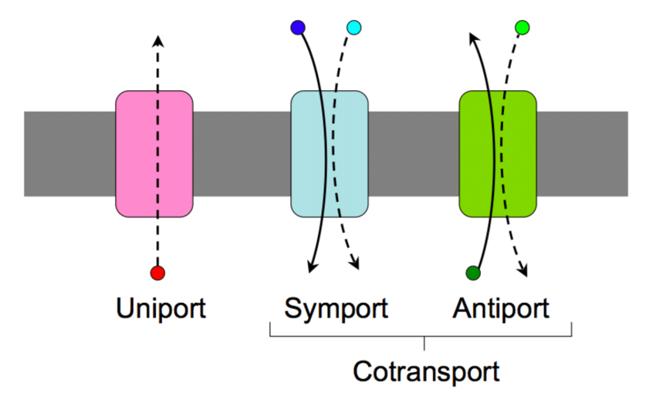

Slide 39
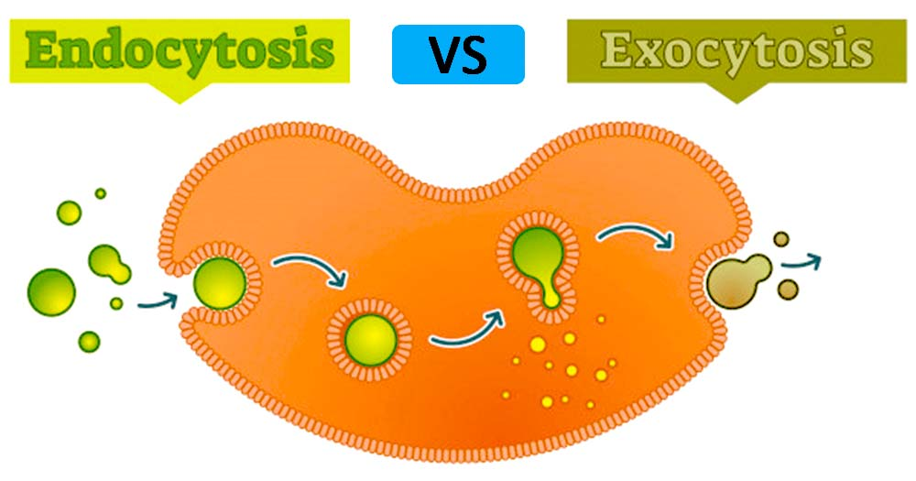
Vesicular transport
Comprises of Endocytosis and Exocytosis
Both involves formation of vesicles from the cell

Slide 40
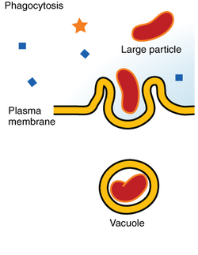
Phagacytosis

Slide 41
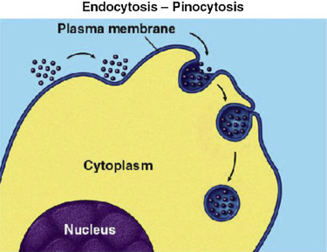
Pinocytosis

Slide 42
Thank you

