Slide 1
LIPID CHEMISTRY
Dr. S.Suganya
Department of Biochemistry

Slide 2
Definition
Heterogenous group of compounds insoluble in water,soluble in organic solvents like chloroform, ether and benzene
They are esters of fatty acids with alcohol and are utilized by living organisms

Slide 3
BMI
Storage form of energy (Triglycerides)
Structural component of biomembranes (Phospholipids and Cholesterol)
Metabolic regulators (Steroid hormones and prostaglandins)
Act as surfactants, detergents and emulsifying agents (Amphipathic lipids)
Act as electric insulators in neurons
Help in the absorption of fat soluble vitamins

Slide 4





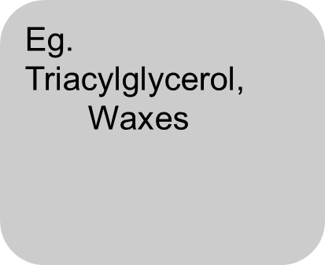
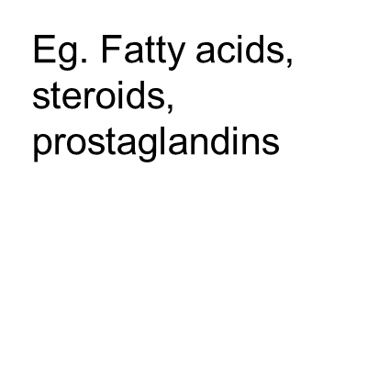
Phospholipids
Glycolipids
Lipoprotein

Slide 5
Definition
Simple lipids:
- esters of fatty acid with various alcohols.
Compound lipids:
- esters of fatty acid with alcohol containing additional groups
Derived lipids
- products obtained after the hydrolysis of simple or compound lipids

Slide 6
Simple lipid
TAG – triacylglycerol
- ester of fatty acid with alcohol glycerol
- they are uncharged and termed as neutral fat
- fat we eat mostly are TG

Slide 7
Waxes
- esters of fatty acid with HMW monohydric long chain alcohol
Eg. Bees wax, spermaceti oil

Slide 8
Compound lipid
Phospholipid
Glycolipid
lipoprotein

Slide 9
Phospholipid
Lipids containing in addition to fatty acid and an alcohol, a PHOSPHORIC ACID residue
Classified into
Glycerophospholipid
Sphingophospholipid

Slide 10
Glycerophospholipid
Alcohol present is glycerol
Phosphatidyl choline
Phosphatidyl ethanolamine
Phosphatidyl serine
Phosphatidyl inositol
Lysophospholipid
Plasmalogens
Cardiolipins

Slide 11
Sphingophospholipids
Alcohol present is sphingosine
Sphingomyelins

Slide 12
Glycolipids
Fatty acid , alcohol sphingosine with CHO with nitrogen base
No phosphate group
Cerebrosides
Gangliosides

Slide 13
Functions
Major lipid of cell membrane
Regulate the permeability of membrane
Regulate activation of some membrane bound enzyme
Acts as lipotropic factor
Good emulsifying agent

Slide 14
Lipoproteins
Combination of lipid with prosthetic group protein
Chylomicrons
VLDL
LDL
HDL

Slide 15
Functions
Chylomicron – transport dietary lipid from intestine to peripheral tissues
VLDL – transport of TAG from liver to peripheral tissues
LDL – transport of cholesterol from liver to peripheral tissues
HDL – transport of free cholesterol from peripheral tissues to liver

Slide 16
Derived lipids
Products obtained after hydrolysis of simple and compound lipid
Fatty acid
Steroids
Cholesterol
Lipid soluble vitamins
Ketone bodies

Slide 17
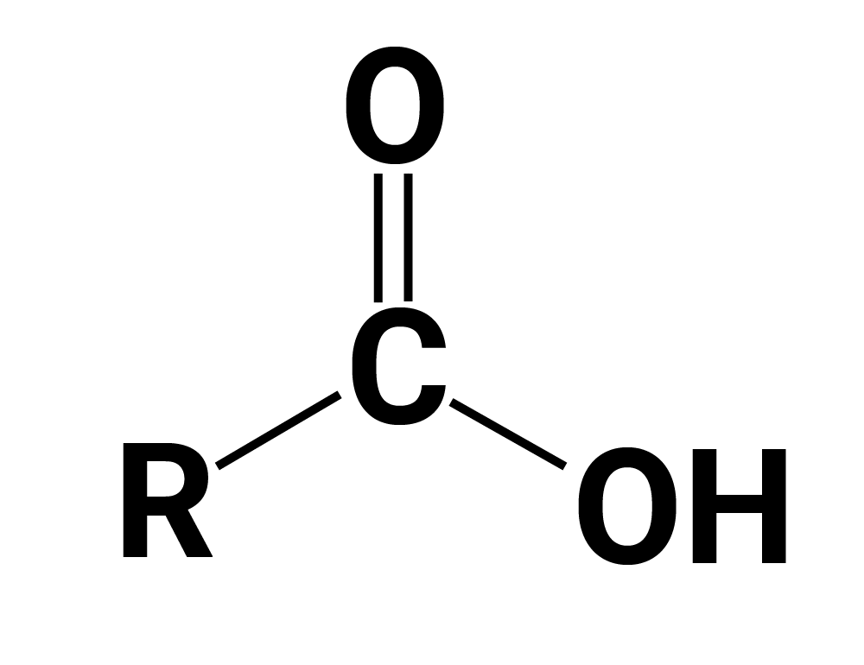
Fatty acid
Carboxylic acid with hydrocarbon chains

Slide 18
R stands for hydrocarbon chain
Amphipathic in nature`

Slide 19
Classification of fatty acid
Straight chain fatty acid
Branched chain fatty acid
Substituted fatty acid
Cyclic fatty acid

Slide 20
Straight chain fatty acid
Fatty acid with carbons arranged linearly
Saturated fatty acid (no double bond)
Unsaturated fatty acid ( contain double bond)

Slide 21
Branched chain fatty acid
Less abundant than straight chain fatty acid
Isovaleric acid
Isobutyric acid

Slide 22
Substituted fatty acid
One or more hydrogen bond is replaced by another group
Lactic acid of blood
Cerebronic acid of brain glycolipid
Ricinoleic acid of castor oil

Slide 23
Cyclic fatty acid
Bearing cyclic group presentation in some bacteria and seed lipids
Hydnocarpic acid

Slide 24
Function of fatty acid
Serve as building block of phospholipid and glycolipid
Derivatives serve as hormones
Serve as major fuel for most cells

Slide 25
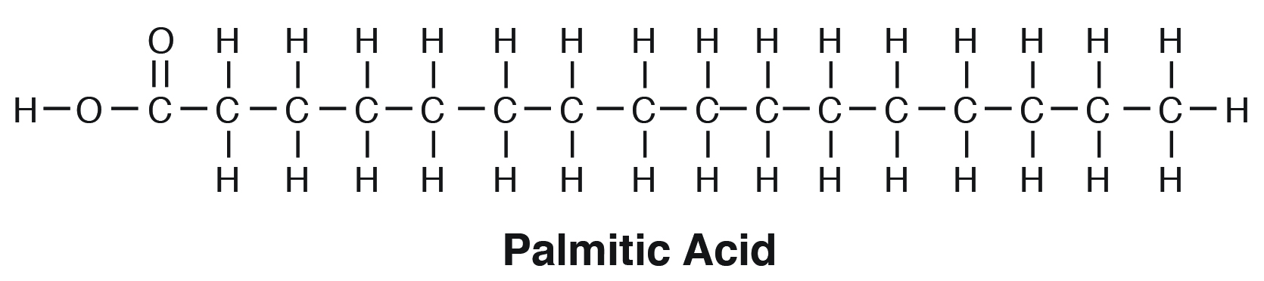
Numbering of fatty acid
Starting from COOH terminal
Carbon 2 and 3 referred as alpha and beta
CH3 is at distal end and called as omega carbon

Slide 26
Essential fatty acid
Required for optimal health and cannot synthesized by body and should be supplemented in the diet
Linoleic acid; linolenic acid
Arachidonic acid can be synthesized from linoleic acid

Slide 27
Function
Synthesis of Eicosanoids
Maintains of structural integrity
Development of Retina and Brain
Skin protector
Antiatherogenic effect

Slide 28
Deficiency
Scaly skin
Eczema
Loss of hair
Poor wound healing

Slide 29
Reaction of lipids
Saponification
Hydrogenation
Peroxidation
rancidity

Slide 30
TAG
Esters of fatty acid with glycerol
TAG consists of 3 FA which is esterified through their carboxyl group resulting in loss of negative charge
Hence uncharged and named as neutral fat

Slide 31
Types
Simple TAG- same FA in all 3 position
Mixed TAG – two or more different FA
C1 saturated
C2 unsaturated
C3 either of the two

Slide 32
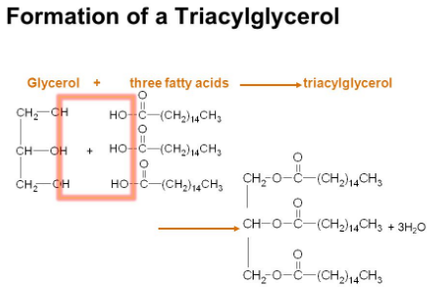

Slide 33
Cholesterol
Major sterol in animal tissues
19 carbon atoms steroid nucleus phenathrene
Methyl side chain at C10 and C13 position
27 carbon compound, 8 carbon side chain attached to D ring at C17, hydroxyl group attached to C3 with one double bond b/w C5 and C6

Slide 34
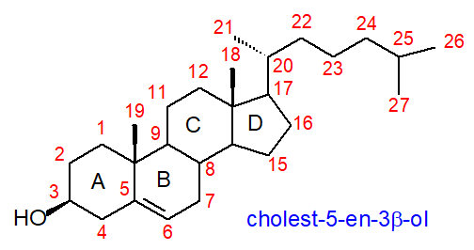

Slide 35
Functions
Major structural constituent of cell membrane
Serves as precursor of
Steroid hormones
Bile acids
Vitamin D

Slide 36
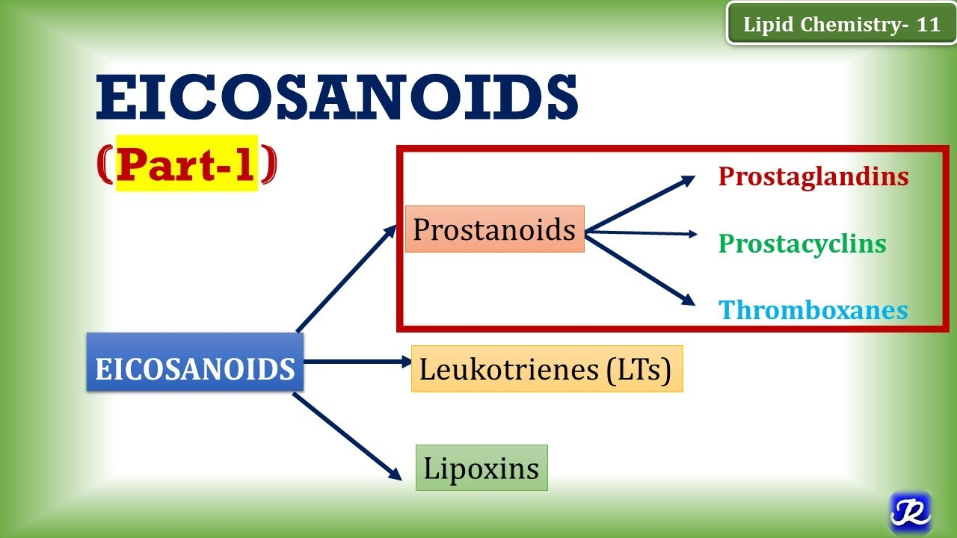
Eicosanoids
They are 20 C compounds derived from arachidonic acid

Slide 37
Eicosanoids
Prostinoids
Leukotrienes
lipoxins

Slide 38
Prostagladins
Derive their name from the tissue in which they were 1st recognized but they are now almost present in all tissues
Parent compound is prostanoic acid
Act as local hormones
Contains a five carbon ring
-OH group is present at C15
Prostaglandins – PGD2, PGE2, PGF2, PGI2 and TXA2

Slide 39
Functions
Causes vasodilatation and inhibits platelet aggregation
Causes vasoconstriction and Platelet aggregation
Medical termination of pregnancy
Bronchodilator
Inhibits gastric secretion – can be used for treatment of acid peptic diseases

Slide 40
Thromboxanes
Isolated from blood platelets, thrombocytes- hence the name
Six membered oxane ring

Slide 41
Functions
Abbreviated as Tx
TxA2 produced by platelets promotes platelet aggregation
Causes TxA2 smooth muscle contraction

Slide 42
Leukotrines
Conjugated trienes
5 sub classes(A to E)

Slide 43
Functions
Facilitate chemotaxis, inflammation, allergic reaction

Slide 44
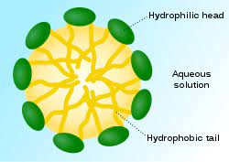
Micelles

Slide 45
THANK YOU

