Slide 1
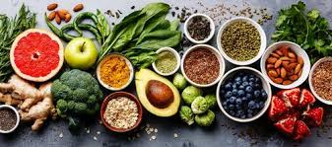
NUTRITION IN NON-COMMUNICABLE DISEASE

Slide 2
INTRODUCTION
NCDs, also known as chronic diseases, are not transferable between people, are generally long-lasting
They fall into four categories:
Cardiovascular diseases (like heart attacks and stroke);
Cancers;
Chronic respiratory diseases (like asthma) and
Diabetes (with diabetes type-2 linked to obesity).

Slide 3
NCDs are linked to genetics, lifestyle, age group, activity level, behavior, and social environment.
Noncommunicable diseases (NCDs) kill 41 million people each year, equivalent to 71% of all deaths globally.
Each year, more than 15 million people die from a NCD between the ages of 30 and 69 years; 85% of these "premature" deaths occur in low- and middle-income countries.

Slide 4
77% of all NCD deaths are in low- and middle-income countries.
Cardiovascular diseases account for most NCD deaths, or 17.9 million people annually, followed by cancers (9.3 million), respiratory diseases (4.1 million), and diabetes (1.5 million).
These four groups of diseases account for over 80% of all premature NCD deaths.

Slide 5
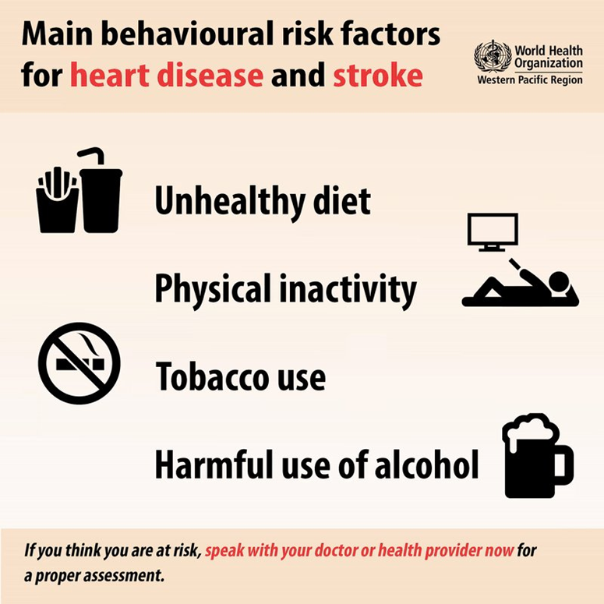
Causes of NCD

Slide 6
They start from a person living an unhealthy lifestyle.
They are not transmitted from person to person.
They grow slowly and stay on for very long.
They affect many important organs in the body: - Brain, heart, arteries, blood vessels, lungs, stomach, intestines, liver, pancreas, spleen,kidneys, bladder, uterus, ovaries and prostate

Slide 7
NUTRITION
Nutrients provide nourishment.
Proteins, carbohydrates, fat, vitamins, minerals, fiber, and water are all nutrients.
If people do not have the right balance of nutrients in their diet, their risk of developing certain health conditions increases.
Types
Macronutritents
Micronutrients

Slide 8
Nutrition in CVS disease
A large body of scientific evidence has reported that nutrition might be the most preventive factor of CVD death , and could even reverse heart disease.
On the other hand, diet seems to play an important role in the management of other risk factors, such as excess weight, hypertension, diabetes, or dyslipidemia.
In this sense, the identification and classification of nutrients, foods, or dietary patterns that can enhance CVD prevention is a priority.

Slide 9
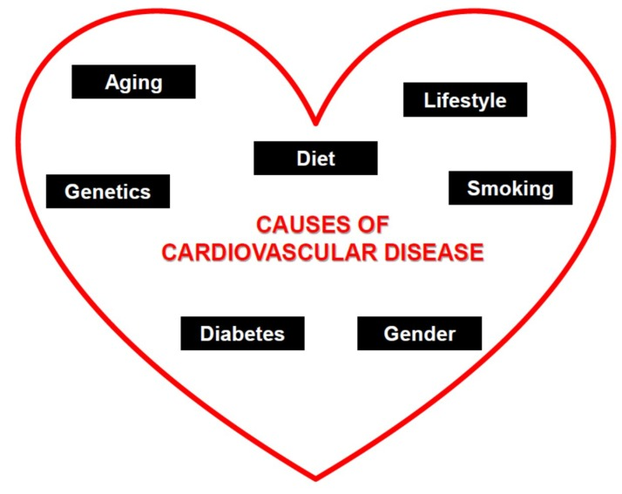

Slide 10
DIETARY PATTERNS
Several studies correlate healthy dietary patterns
Types
Mediterranean Diet
DASH diet

Slide 11
MEDITERRANEAN DIET
Associated with better control of risk to Improve BP, Lipid profile, Glucose metabolism, Arrythmic risk
Other authors suggests that this diet may exert Anti- inflammatory effect in vascular wall as a possible mechanism to explain the link B/W diet and Low CVD.

Slide 13
The observational study ATTICA evaluated the link B/W Mediet and MetS in 1528 women and 1514 men suggested that 15% lower odds of CVD incidence.
PREDIMED study suggested that low prevalence of CV after five years of Mediet.

Slide 14
DASH DIET
This pattern is linked to improvement in BP, body weight, Glucose-insulin metabolism and total mortality.
This diet has reported improvements on insulin resistance, inflammation, oxidative stress.

Slide 15
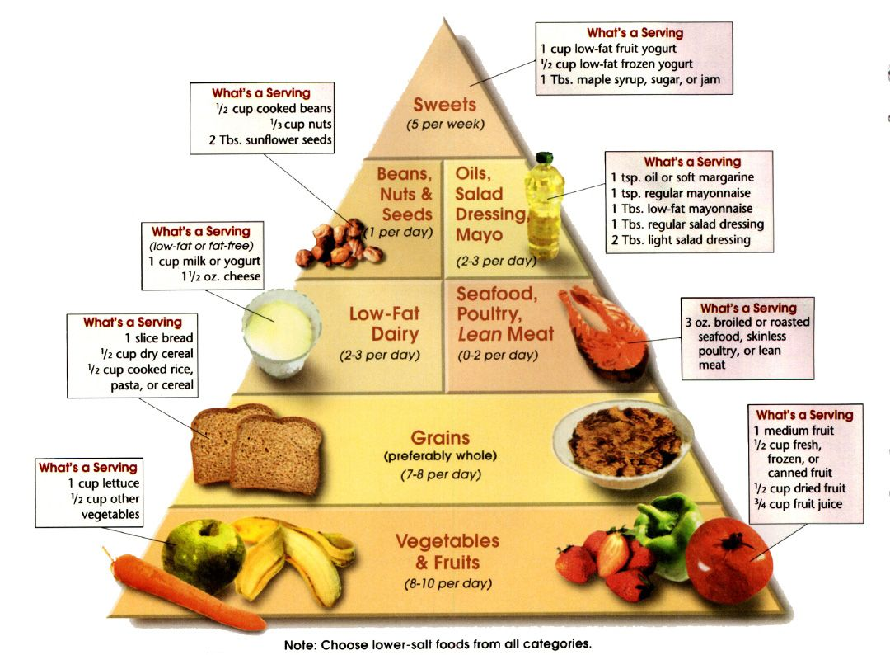

Slide 16
CONCLUSION
The challenge is promoting healthy dietary habits as well as active life style in children and young adults.

Slide 17
NUTRITION IN CANCER
American institute for cancer research and the world cancer research fund estimated that 30- 40 % cancer can be prevented by appropriate diets.
Eating too much food is the one of the risk factors for cancer.
Overweight and obesity accounted that 14 % of cancer death in men and 20 % of cancer death in women.

Slide 18
LOW FIBER
RED MEAT
FLAX SEED
FRUITS & VEGETABLES
CRUCIFEROUS VEGETABLES

Slide 19


Slide 20
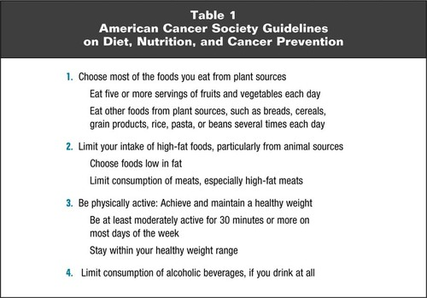
CONCLUSION

Slide 21
NUTRITION IN DIABETES
Medical nutritional therapy is an integral component of diabetes management and diabetes self management.
GOAL OF MEDICAL NUTRITION THERAPY
Attain and maintain optimal metabolic outcomes
Prevent and treat chronic complication of diabetes
Improve health through healthy food choices and physical activities
Address individual nutritional needs

Slide 22
Carbohydrates and diabetes
Protein and diabetes
Dietary fats and diabetes
Micronutrients and diabetes
Alcohol and diabetes
Pregnancy and diabetes

Slide 23
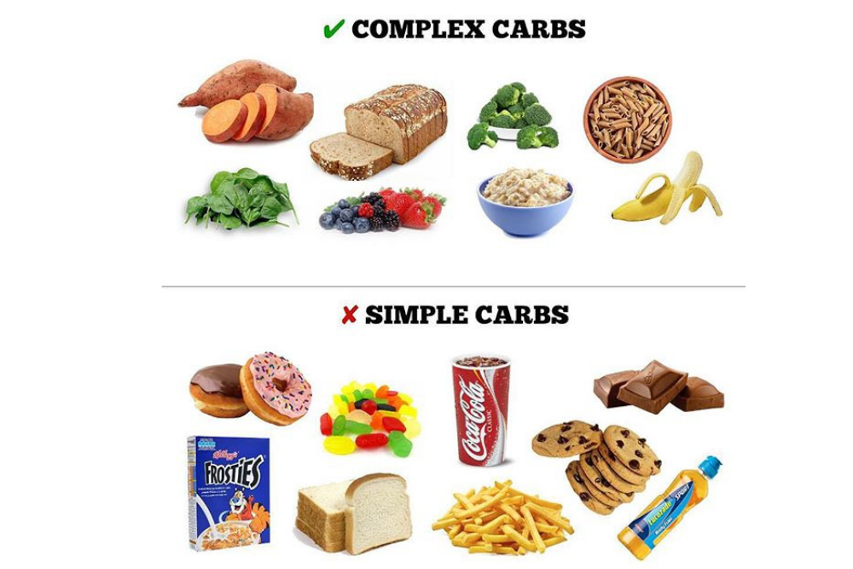

Slide 24
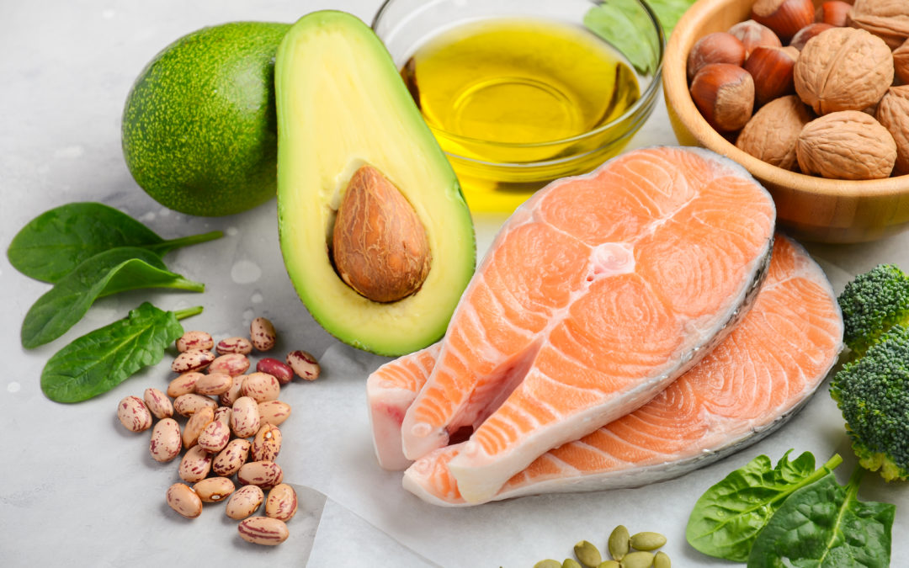

Slide 25
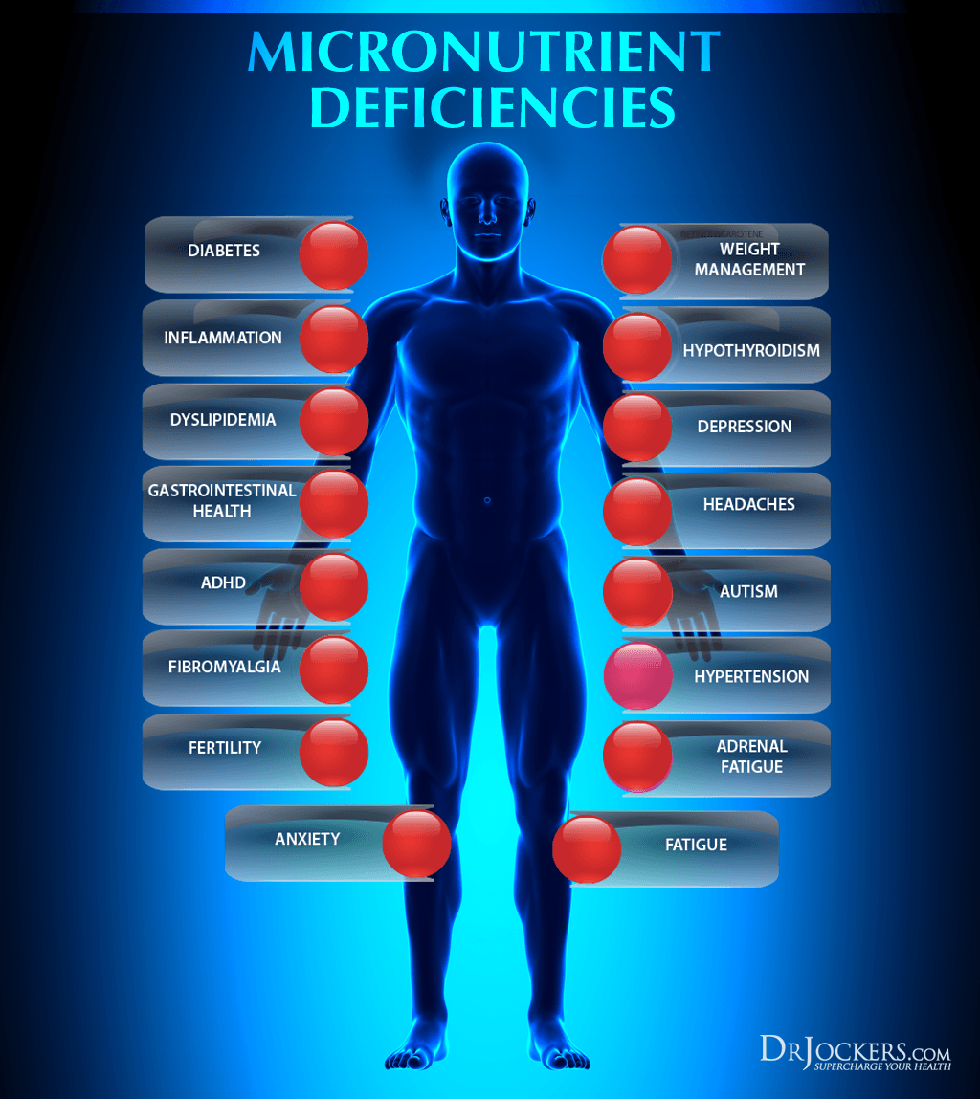

Slide 26
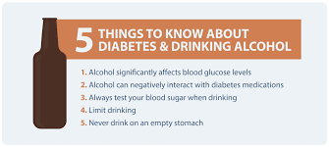

Slide 27


Slide 28
References
Donaldson MS. Nutrition and cancer: a review of the evidence for an anti-cancer diet. Nutr J. 2004;3:19. Published 2004 Oct 20. doi:10.1186/1475-2891-3-19
Casas R, Castro-Barquero S, Estruch R, Sacanella E. Nutrition and Cardiovascular Health. Int J Mol Sci. 2018;19(12):3988. Published 2018 Dec 11. doi:10.3390/ijms19123988
Scoditti E, Massaro M, Garbarino S, Toraldo DM. Role of Diet in Chronic Obstructive Pulmonary Disease Prevention and Treatment. Nutrients. 2019;11(6):1357. Published 2019 Jun 16. doi:10.3390/nu11061357
Franz, Marion & Bantle, John & Beebe, Christine & Brunzell, John & Chiasson, Jean-Louis & Garg, Abhimanyu & Holzmeister, Lea & Hoogwerf, Byron & Mayer-Davis, Elizabeth & Mooradian, Arshag & Purnell, Jonathan & Wheeler, Madelyn. (2004). Nutrition Principles and Recommendations in Diabetes. Diabetes care. 27 Suppl 1. S36-46. 10.2337/diacare.27.2007.S36.

Slide 29
THANK YOU

