Slide 1
Urea Cycle Disorders

Slide 2
Introduction
Genetic disorder caused by mutation which results in deficiency of one of the five enzyme
C/F:
1 in 30000 live births
Hyperammonaemia
Encephalopathy
Respiratory alkalosis

Slide 3
Urea Cycle
Krebs – Henseleit cycle / Ornithine cycle
Urea is formed from Ammonia, CO2 and Aspartate
Site: Liver
Subcellular Site: Mitochondria / Cytosol

Slide 4
Ammonia is trapped as Glutamine
Brain & Kidney – small amount of Ammonia is generated and trapped
Ammonia is Toxic
Normal concentration- 10-20microgm/dL

Slide 5
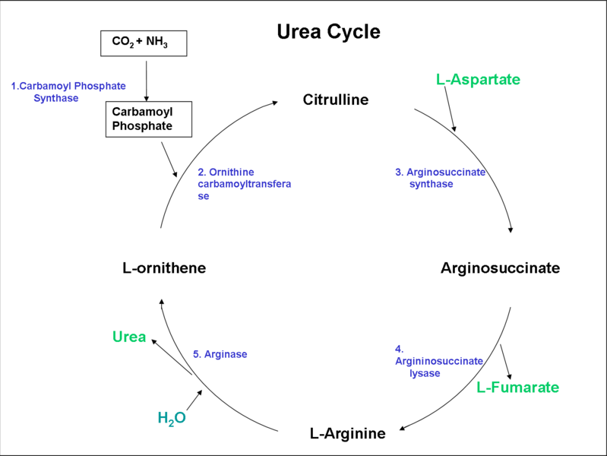
Urea Cycle

Slide 6
Regulation of Urea Cycle
Coarse Regulation:
Starvation
Protein rich diet
Fine Regulation:
Allosteric regulation- NAG activates CPS I
Compartmentalization:
1st two enzymes are in Mitochondria
Rest in cytoplasm

Slide 7
Urea cycle disorders

Slide 8
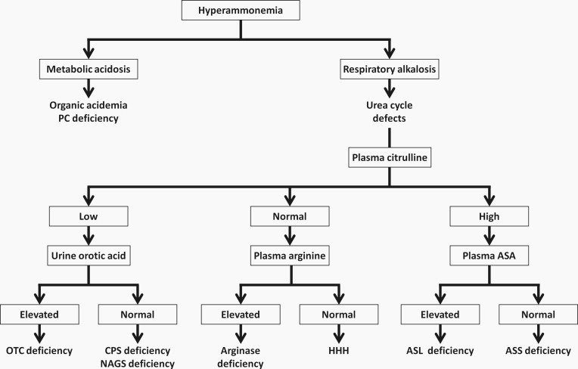

Slide 9
Hyperammonaemia Type 1
Rare and characterized by severe hyperammoneamia
Defect- CPS 1
Autosomal recessive
Gene 2q35
Incidence : 1 in 100,000
C/F: MR

Slide 10
NH3 + CO2 Carbamyl phosphate
CPS
NAG

Slide 11
Clinical Features
Refusal to eat
Vomiting
Lethargy
Convulsion
Coma

Slide 12
Lab investigations
Hyperammonaemia without increase in specific AA
Increased glutamine and alanine secondary to Hyperammonemia
Urine orotic acid low / nil

Slide 13
Treatment
Oral administration of Carbamylglutamate

Slide 14
Hyperammonaemia Type 2
X linked trait
Hemizygous males than heterozygous female
Defect- OTC

Slide 15
Carbomyl phosphate Citrulline
OTC

Slide 16
Clinical Manifestation
Ataxia
Mental confusion
Vomiting
Agitation
Occurs after ingestion of High protein Diet

Slide 17
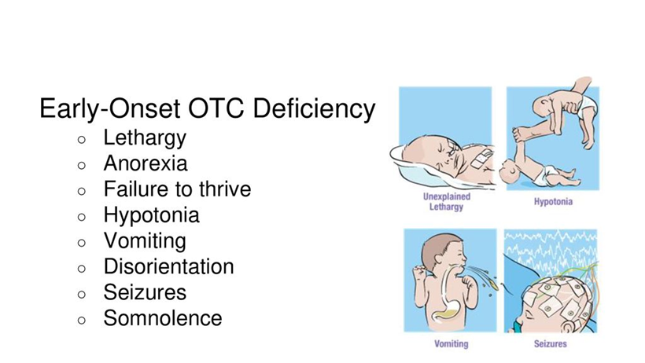

Slide 18
Lab investigations
Hyperammonemia without increase in any specific AA
Increase in glutamine and alanine secondary to hyperammonemia
Increased in Urinary orotic Acid
Mimic lysinuric protein intolearnce

Slide 19
Identification of Mutant gene
Pre natal- Liver biopsy
DNA analysis from Chronic Villous Samples

Slide 20
Treatment
Liver transplantation

Slide 21
Citrullinemia
Autosomal Recessive
Defect- Arginosuccinate synthase
Type I
Type II

Slide 22
Citrulline + aspartic acid ASA
ASA synthetase

Slide 23
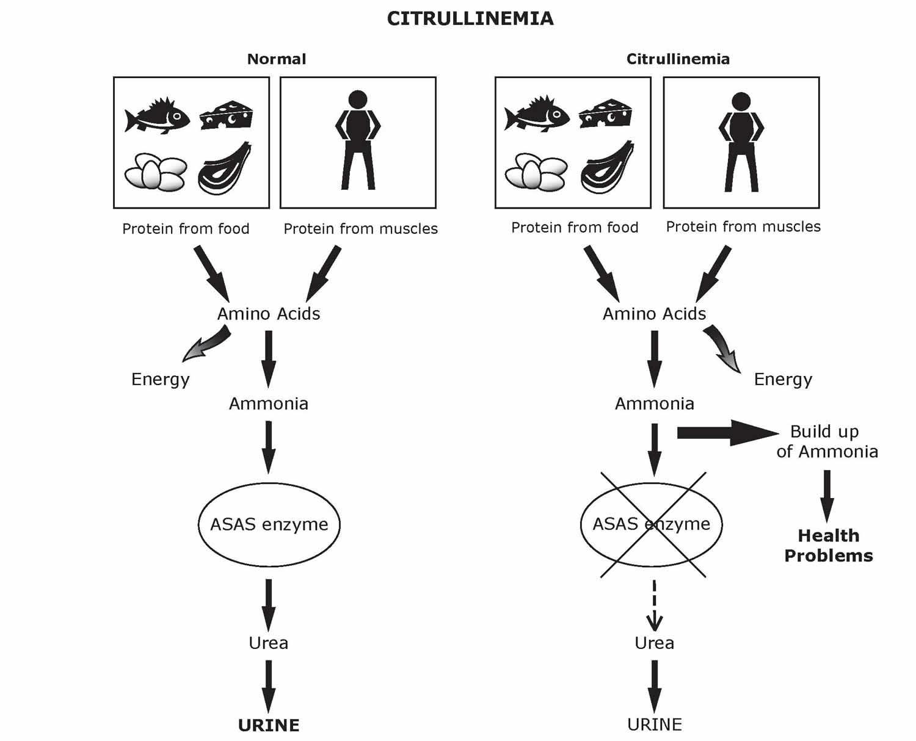

Slide 24
Type I citrullinimia
Severe / Neonatal form- first few days of Life
Subacute / mild form – FTT, frequent vomiting, Developmental Delay, dry and brittle Hair
Gradually after 1yr of Life
AR
9q34

Slide 25
LAB:
Plasma citrulline increased
Urine orotic acid increased

Slide 26
Prenatal – CVS DNA analysis
Enzyme activity
TREATMENT:
Arginine
Prognosis is poor
Protein restricted diet with sodium benzoate and arginine

Slide 27
Type II citrulinimia
Defect: Citrin
SLC25A13
7q21.3
Transport Aspartate from mitochrondria to cytoplasm
2 types
Type II neonatal form
Type II adult form

Slide 28
Type II neonatal form
Known as neonatal hepatic cholestasis
3months of age
Include jaundice with mild hyperbilirubinemia
Hypoproteinimia
Increased PT
Increased ALP

Slide 29
Lab Investigation
Plasma ammonia and citrulline normal
Increased methionine, tyrosine, alanine
Increased AFP
Liver biopsy: fatty infiltration, cholethiasis with dilated canaliculi, fibrosis
Seen in JAPAN

Slide 30
Type II Adult form
Disorientation
Delirium
Delusion
Tremor
Frank psychosis
20-40yrs
Liver transplantation

Slide 31
Arginosuccinate Aciduria
Defect- arginosuccinate Lyase
AR
7cen q 11.2
1st few days of Life
Mortality high
Dryness and brittle Hair ( trichorrechexis nodosa)

Slide 32
Arginosuccinic Acid Arginine
ASA lyase

Slide 33
Lab Investigation
Increased Liver enzymes
Increased Glutamine & alanine
Increased Citrulline
ASA found in Urine and CSF

Slide 34
Hyperarginemia
Mild variety
2-4yrs of age
Defect- arginase
AR
Two enzymes
Cytosolic A1( liver and erythrocyte)
Renal and brain mitochrondria (6q23)

Slide 35
Arginine ornithine
Arginase

Slide 36
Clinical Features
Rare
Insidious onset
Remain asymptomatic
Progressive spastic diplegia with scissoring lower extremities
Developmental delay
MR
Seizure

Slide 37
LAB INVESTIGATION
Increased arginine
Urine orotic Acid increased
Diagnosis: arginine in urine
Treatment:
Low protein diet
Adm of synthetic protein made of essential AA
Sodium benzoate

Slide 38
HHH syndrome
Defect- ornithine transporter
AR
SLC25A15
Hyperornithinemia, hyperammonemia, homocitrullinemia
Transport system from cytosol to mitochondria
Accumulation of ornithine in cytosol
Defn of ornithine in mitochondria

Slide 39
Clinical features
Vomiting
Lethergy
Refusal to feed
Increased DTR
Seizures
Clonus

Slide 40
Lab Investigation
Increased plasma ornithine
Increased plasma Homocitrulline

Slide 41
Transient Hyperammonaemia of New Born
Very low birth infant – mild which last for about 6-8weeks
Asymptomatic follow up to 18months
Severe transient hyperammonaemia- observed in New born infant with premature and respiratory distress

Slide 42
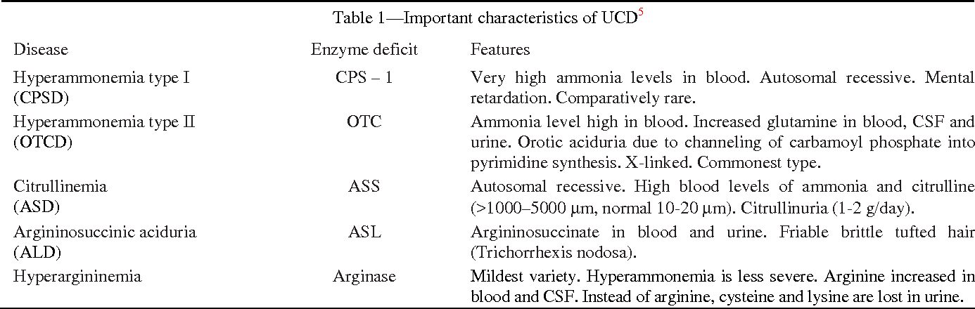

Slide 43
Acquired Hyperammonaemia
Liver cirrhosis
Loss of hepatocytes
Replaced by fibrous connective tissue
Impairs the blood flow

Slide 44
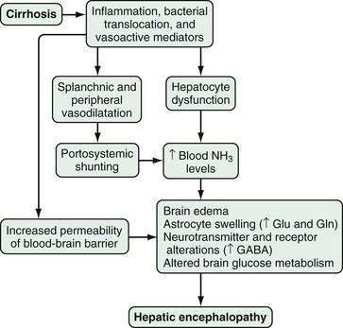

Slide 45
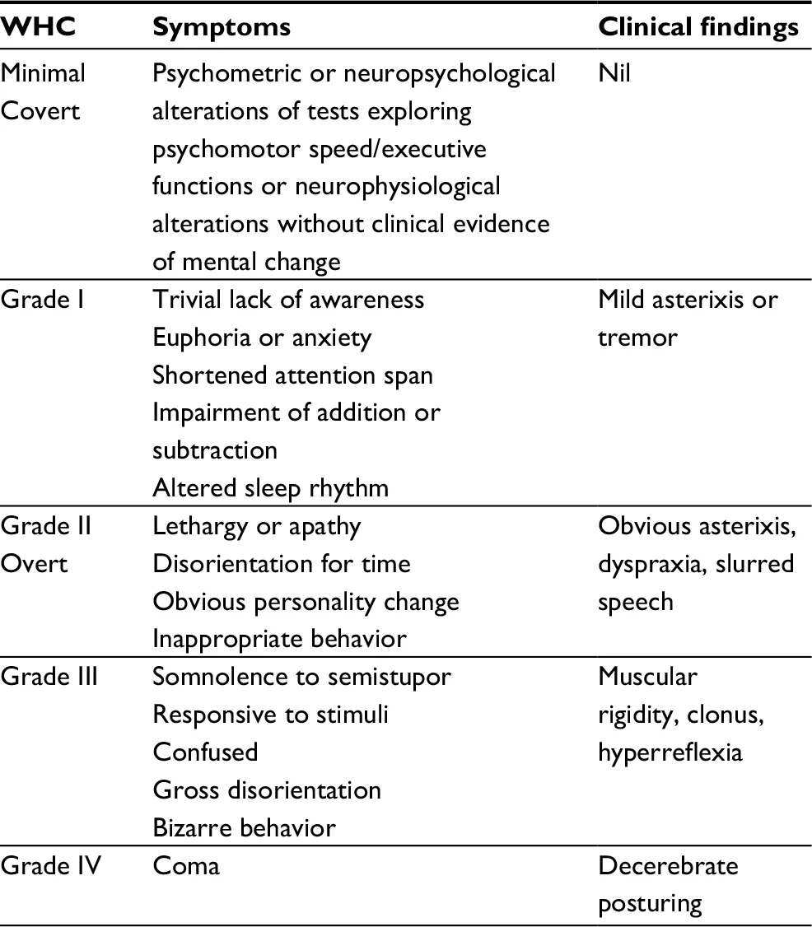

Slide 46
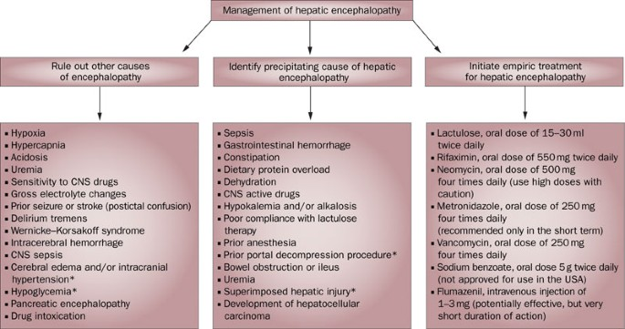

Slide 47
Ammonia Estimation
Formed from deamination of AA during protein metabolism
Removed from circulation and converted into urea
Free ammonia is toxic and present in plasma in low concentration

Slide 48
Physiology
NH3 is formed from the catabolism of AA & bacterial metabolism in Lumen of Intestine
NH3 consumed by parenchymal cells of Liver to produce Urea
Normal physiologic pH it is ammonium ion and excreted by kidney and act as buffer

Slide 49
Monitoring NH3 used in the prognosis
Arterial NH3 is the best indicator of the severity of disease
Used in
Hepatic failure
Reye’s syndrome
Inherited UCD

Slide 50
methods for estimation
Chemical methods
Enzymatic method

Slide 51
Chemical methods
Ion selective electrode
First method developed by Conway in 1935
Diffuse of NH3 through Ion selective membrane into NH4cl
Due to this there is change in pH
And this is measured potentiometrically

Slide 52
2. Spectrophotometric
NH3+BPB----- Blue dye

Slide 53
Enzymatic method
Glutamate dehydrogenase
NH4+2oxoglutarate+NADPH+H------- Glutamate + NADP+H2O

Slide 54
SPECIMEN
Venous blood without any trauma and placed immediately in Ice pack
Centrifuge 0˚ to 4˚C within 20mins
Analysed as soon as possible/frozen(-20˚C)
Erythrocytes contains two or three times much ammonia

Slide 55
Interferance
Ammonium salts
Asparginase
Barbiturates
Diuretics
Ethanol
Cigrette smoking

Slide 56
Others
Diphenhydraine
Lactobacillus acidophillus
Lactulose
Levadopa
Will decrease the concentration of NH3
Glucose conc., greater than 600mg/dL interference in dry chemistry systm

Slide 57
Normal values
Child – 68-136microgm/dL
Adult- 19-60microgm/dL

Slide 58
NH3 is not removed then blood conc., increased and leads to encephalopathy

Slide 59
Reference
Tietz clinical biochemistry
Clinical chemistry – Michael L Bishop
Nelson paediatrics

Slide 60
Thank you

